Slide 1

00
Paper Review
LearnData Lab
LearnData Lab @SKKU
3월 31일 중간 과정 자료
Natural Language Processing and Commonsense Reasoning for the Next of QnA System
정지원

Slide 2
01
Study Meeting
LearnData Lab
LearnData Lab @SKKU
Contents
01
생각
내용
그림(OpenBookQA in QAGNN + Cycle-encoder
02
전체 그래프

Slide 3
02
Study Meeting
LearnData Lab
LearnData Lab @SKKU
생각
Other node’s text embedding이 필요한가?
Other node의 텍스트 정보 없이 그래프의 사이클 개수와 같은 통계적 기반으로 가능하다 생각했었음
하지만 이는 지금까지 했던 방향과 다른게 없음 -> 사이클의 역할을 파악하기에 불충분하다 생각함(교수님의 피드백이 맞다고 생각합니다.)
QA-GNN은 subgraph에 속한 노드의 개수가 200개이며 GAT를 거치는데 5-hop을 봄
옆에 그림처럼 사이클의 정보를 받아서 context node로 전달 가능함
그렇기 때문에 other node가 어떤 text인지에 따라 사이클의 역할이 뭔지 파악 가능함(e.g other node가 질문과 정답의 문맥과 관련되면서 단일 text(question, answer node)와 연결된 것이면 저 정보를 잘 받아들이도록 학습하는지 안하는지 파악 가능할 것
이러한 사이클은 긍정의 사이클인데 cycle encoder가 이 사이클의 가중치가 높도록 학습한다면 cycle encoder의 긍정적 영향 파악 가능함
부정의 사이클은 단순이 질문과 정답의 문맥과 관련없이 단일 text(question, answer node)와 관련성이 있는 other node와 사이클을 형성할 때 -> cycle encoder가 이러한 사이클의 가중치는 낮아지도록 학습한다면 Cycle encoder의 긍정적 영향 파악 가능함

Slide 4
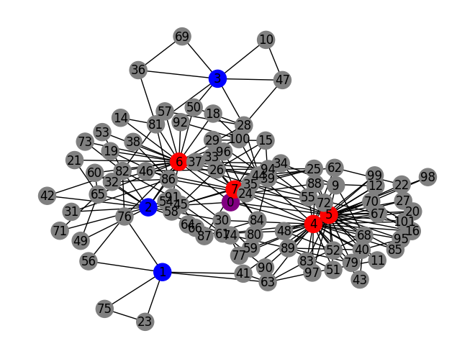
03
Study Meeting
LearnData Lab
LearnData Lab @SKKU
OpenBookQA(7-903)
Q. “The main component in dirt is”
A. microorganisms B. broken stones C. pollution D. bacteria
stone
main
Total cycle 개수 : 187개
C, Q, A cycle 개수 : 106개
Context node 사이클 : 2개
Question node(1,2,3) 사이클
1 -> 3, 2 -> 10, 3 -> 5
Answer node(4~7) 사이클
4 -> 30, 5 -> 19, 6 -> 22, 7 -> 17
stones
dirt
component
broken
break

Slide 5
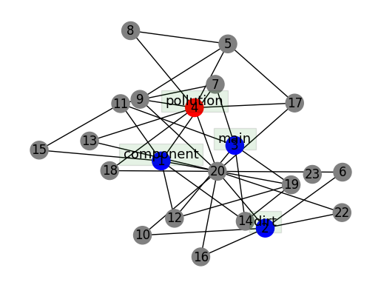
03
Study Meeting
LearnData Lab
LearnData Lab @SKKU
OpenBookQA(7-903)-QAGNN
Q. “The main component in dirt is”
A. microorganisms B. broken stones C. pollution D. bacteria
Total cycle 개수 : 35개
C, Q, A cycle 개수 : 18개
Context node 사이클 : 0개
Question node(1,2,3) 사이클
1 -> 4, 2 -> 4, 3 -> 3
Answer node(4) 사이클 : 7개

Slide 6
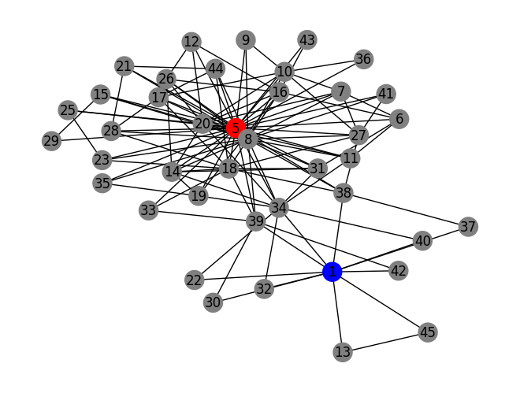
03
Study Meeting
LearnData Lab
LearnData Lab @SKKU
OpenBookQA(7-511)
Q. “It is easier for human’s to survive in”
A. a cave B. the ocean C. a town D. alone
town
Total cycle 개수 : 84개
C, Q, A cycle 개수 : 81개
Context node 사이클 : 0개
Question node(1,2,3,4) 사이클
1 -> 3, 2 -> 10, 3 -> 0, 4 -> 0
Answer node(5) 사이클 : 74개
easier

Slide 7
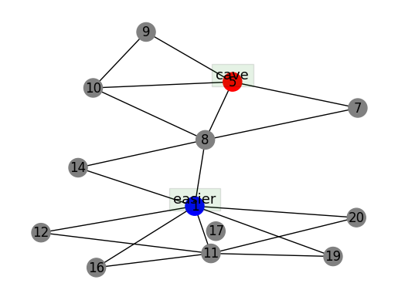
03
Study Meeting
LearnData Lab
LearnData Lab @SKKU
OpenBookQA(7-511)-QAGNN
Q. “It is easier for human’s to survive in”
A. a cave B. the ocean C. a town D. alone
Total cycle 개수 : 10개
C, Q, A cycle 개수 : 8개
Context node 사이클 : 0개
Question node(1,2,3,4) 사이클
1 -> 5, 2 -> 10, 3 -> 0, 4 -> 0
Answer node(5) 사이클 : 3개

Slide 8
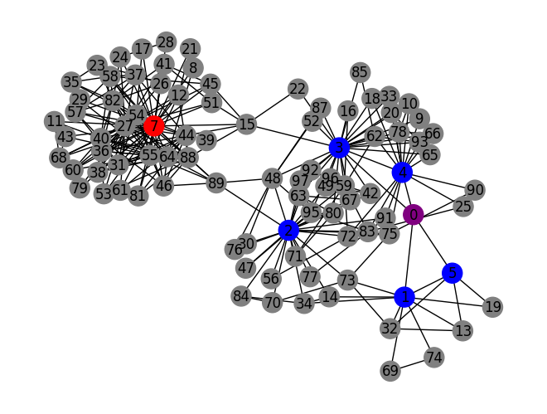
03
Study Meeting
LearnData Lab
LearnData Lab @SKKU
OpenBookQA(9-937)
Q. “A cactus stem is used to store”
A. fruit B. liquid C. text D. spines
Total cycle 개수 : 208개
C, Q, A cycle 개수 : 178개
Context node 사이클 : 2개
Question node(1,2,3,4,5,6) 사이클
1 -> 6, 2 -> 25, 3 -> 22, 4 -> 13, 5 -> 3, 6 -> 0
Answer node(5) 사이클 : 115개
liquid
store
store_liquid
stem
cactus
use

Slide 9
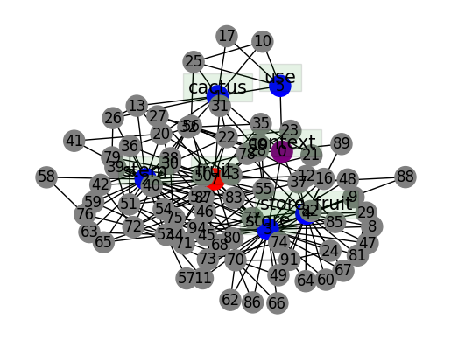
03
Study Meeting
LearnData Lab
LearnData Lab @SKKU
OpenBookQA(9-937)-QAGNN
Q. “A cactus stem is used to store”
A. fruit B. liquid C. text D. spines
Total cycle 개수 : 159개
C, Q, A cycle 개수 : 120개
Context node 사이클 : 1개
Question node(1,2,3,4,5,6) 사이클
1 -> 6, 2 -> 19, 3 -> 27, 4 -> 15, 5 -> 3, 6 -> 0
Answer node(5) 사이클 : 56개

Slide 10
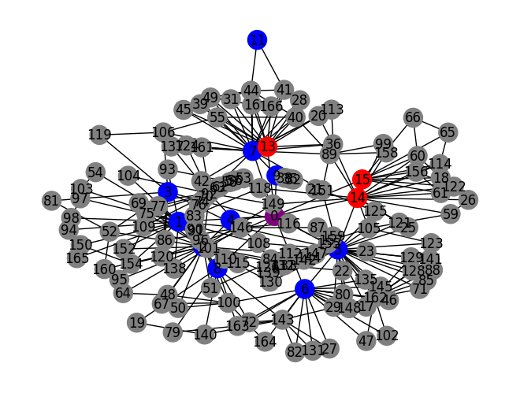
03
Study Meeting
LearnData Lab
LearnData Lab @SKKU
OpenBookQA(7-414)
Q. “As gasoline costs rise, alternative fuels are being used, which means that”
A. Wind power will be expensive B. gas costs will rise C. oil costs will be maintained D. gasoline will be needed less
used
Total cycle 개수 : 315개
C, Q, A cycle 개수 : 138개
Context node 사이클 : 8개
Question node(1~11) 사이클
1 -> 13 2 -> 20, 3 -> 5, 4 -> 1, 5 -> 28, 6 -> 16, 7 -> 22, 8 -> 7, 9 -> 1, 10 -> 0, 11 -> 1
Answer node(12~15) 사이클
12 -> 0, 13 -> 12, 14 -> 16, 15 -> 16
cost
less
mean
rise
needed
costs
need
means
alternative
fuels
fuel
alternative_fuel

Slide 11
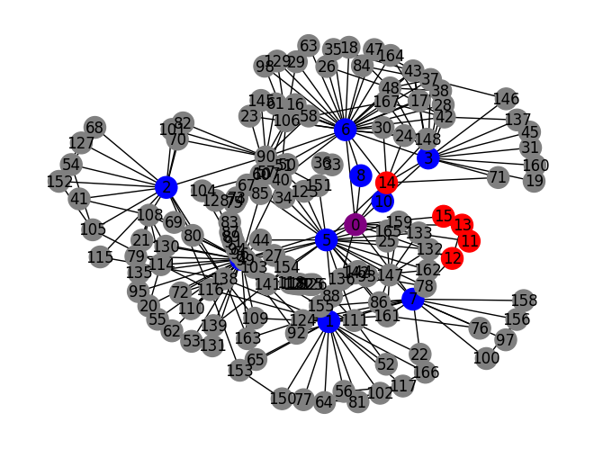
03
Study Meeting
LearnData Lab
LearnData Lab @SKKU
OpenBookQA(7-414)-QAGNN
Q. “As gasoline costs rise, alternative fuels are being used, which means that”
A. Wind power will be expensive B. gas costs will rise C. oil costs will be maintained D. gasoline will be needed less
Total cycle 개수 : 323개
C, Q, A cycle 개수 : 118개
Context node 사이클 : 10개
Question node(1~10) 사이클
1 -> 11, 2 -> 11, 3 -> 14, 4 -> 24, 5 -> 19, 6 -> 31, 7 -> 11, 8 -> 1, 9 -> 0 , 10 -> 1
Answer node(11~15) 사이클
11 -> 2, 12 -> 18, 13 -> 1, 14 -> 36, 15 -> 2
mean
alternative_fuel
fuel
rise
maintained
used
oil
gasoline
maintain
cost
costs
means
fuels
alternative

Slide 12
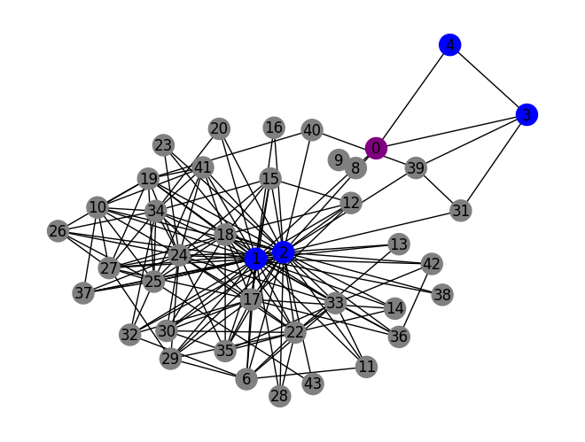
03
Study Meeting
LearnData Lab
LearnData Lab @SKKU
OpenBookQA(1032)
Q. “Which requires energy to move?”
A. weasel B. willow C. mango D. poison ivy
requires
Total cycle 개수 113개
C, Q, A cycle 개수 : 62개
Context node 사이클 : 2개
Question node(1~4) 사이클
1 -> 30, 2 -> 33, 3 -> 2, 4 -> 1
Answer node(5) 사이클 : 0개
require
move
energy

Slide 13
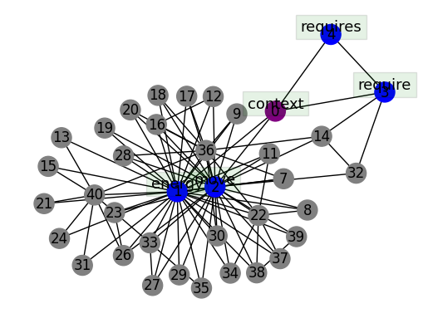
03
Study Meeting
LearnData Lab
LearnData Lab @SKKU
OpenBookQA(1032)-QAGNN
Q. “Which requires energy to move?”
A. weasel B. willow C. mango D. poison ivy
Total cycle 개수 112개
C, Q, A cycle 개수 : 64개
Context node 사이클 : 2개
Question node(1~4) 사이클
1 -> 30, 2 -> 24, 3 -> 2, 4 -> 1
Answer node(5) 사이클 : 0개

Slide 14
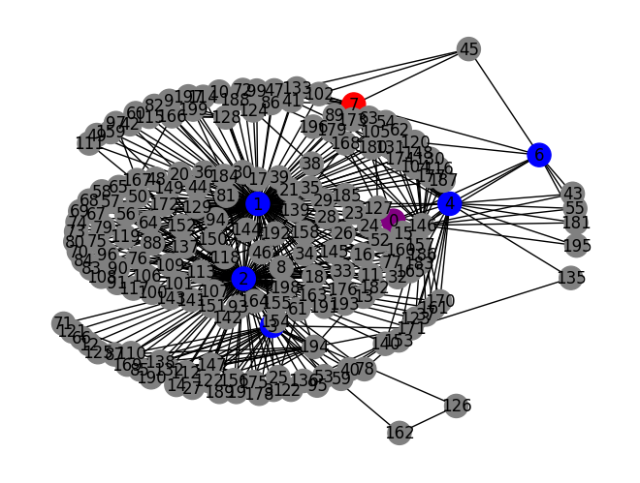
03
Study Meeting
LearnData Lab
LearnData Lab @SKKU
OpenBookQA(889)
Q. “An animal that only eats plants is a “
A. rat B. moth C. chimpanzee D. pig
animal
Total cycle 개수 492개
C, Q, A cycle 개수 : 275개
Context node 사이클 : 7개
Question node(1~6) 사이클
1 -> 137, 2 -> 131, 3 -> 21, 4 -> 29, 5 -> 0, 6 -> 7
Answer node(7) 사이클 : 16개
energy
moth
plants
eats
eat
eat_plants

Slide 15
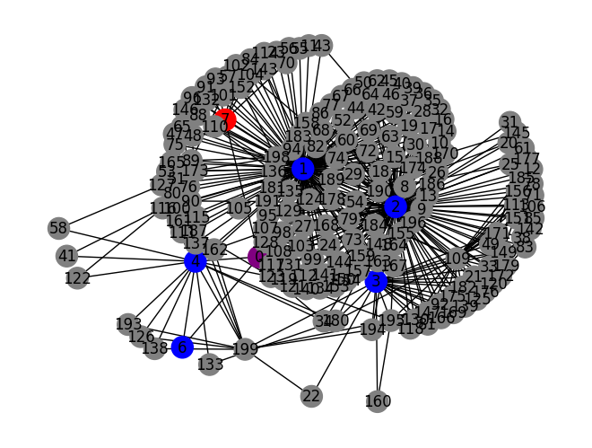
03
Study Meeting
LearnData Lab
LearnData Lab @SKKU
OpenBookQA(889)-QAGNN
Q. “An animal that only eats plants is a “
A. rat B. moth C. chimpanzee D. pig
chimpanzee
Total cycle 개수 444개
C, Q, A cycle 개수 : 262개
Context node 사이클 : 6개
Question node(1~6) 사이클
1 -> 129, 2 -> 131, 3 -> 23, 4 -> 23, 5 -> 0, 6 -> 1
Answer node(7) 사이클 : 20개
eats
plants
eat_plants
animal
eat

Slide 16
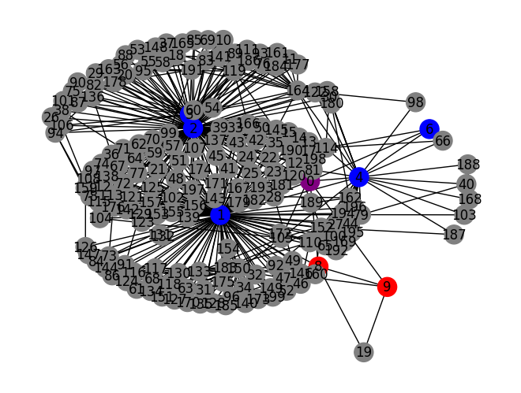
03
Study Meeting
LearnData Lab
LearnData Lab @SKKU
OpenBookQA(1577)
Q. “Which animal eats plants?“
A. eagles B. robins C. owls D. leopards
animal_eat
eat
Total cycle 개수 412개
C, Q, A cycle 개수 : 236개
Context node 사이클 : 7개
Question node(1~7) 사이클
1 -> 120, 2 -> 108, 3 -> 26, 4 -> 24, 5 -> 0, 6 -> 2, 7 -> 0
Answer node(8,9) 사이클
8 -> 8, 9 -> 3
plant
eat_plants
robin
robins
animal

Slide 17
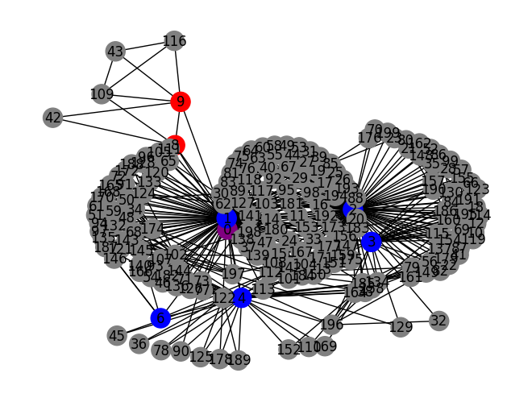
03
Study Meeting
LearnData Lab
LearnData Lab @SKKU
OpenBookQA(1577)-QAGNN
Q. “Which animal eats plants?“
A. eagles B. robins C. owls D. leopards
Total cycle 개수 364개
C, Q, A cycle 개수 : 232개
Context node 사이클 : 7개
Question node(1~7) 사이클
1 -> 117, 2 -> 106, 3 -> 21, 4 -> 32, 5 -> 0, 6 -> 3, 7 -> 0
Answer node(8,9) 사이클
8 -> 7, 9 -> 26
animal
animal_eat
owls
owl
eat
plant
eat_plants

Slide 18
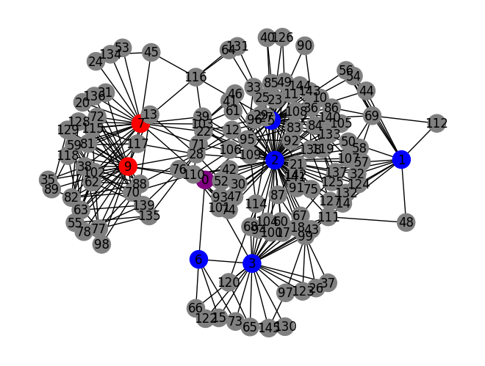
03
Study Meeting
LearnData Lab
LearnData Lab @SKKU
OpenBookQA(1180)
Q. “What is different about birth in humans and chickens?“
A. eagles B. robins C. owls D. leopards
human
Total cycle 개수 365개
C, Q, A cycle 개수 : 198개
Context node 사이클 : 3개
Question node(1~6) 사이클
1 -> 10, 2 -> 62, 3 -> 22, 4 -> 0, 5 -> 30, 6 -> 3
Answer node(7,8,9) 사이클
7 -> 21, 8 -> 0, 9 -> 71
hard
shell
birth
humans
chickens
chicken

Slide 19
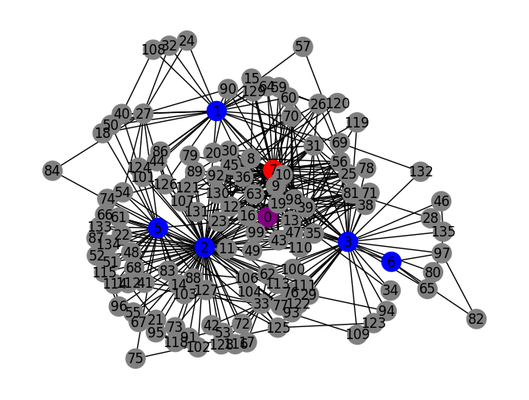
03
Study Meeting
LearnData Lab
LearnData Lab @SKKU
OpenBookQA(1180)-QAGNN
Q. “What is different about birth in humans and chickens?“
A. eagles B. robins C. owls D. leopards
mother
Total cycle 개수 419개
C, Q, A cycle 개수 : 311개
Context node 사이클 : 5개
Question node(1~6) 사이클
1 -> 25, 2 -> 73, 3 -> 36, 4 -> 0, 5 -> 22, 6 -> 3
Answer node(7,8,9) 사이클
7 -> 209, 8 -> 18, 9 -> 24
birth
chickens
humans
human
chicken

Slide 20
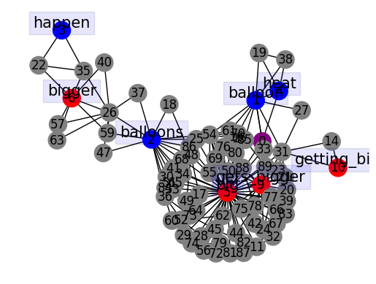
03
Study Meeting
LearnData Lab
LearnData Lab @SKKU
OpenBookQA(132)
Q. “What would happen when ballons heat up?”
A. they get bigger B. they get smaller C. nothing happens D. they fall down
Total cycle 개수 155개
C, Q, A cycle 개수 : 93개
Context node 사이클 : 2개
Question node(1~4) 사이클
1 -> 7, 2 -> 13, 3 -> 1, 4 -> 2
Answer node(5~10) 사이클
5 -> 53, 6 -> 6, 7 -> 0, 8 -> 0, 9 -> 14, 10 -> 1
gets_bigger
big

Slide 21
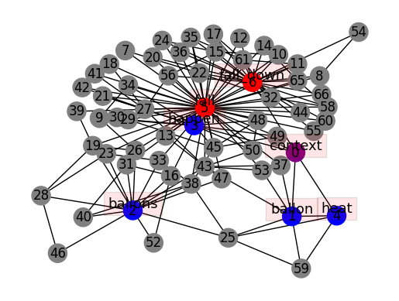
03
Study Meeting
LearnData Lab
LearnData Lab @SKKU
OpenBookQA(132)-QAGNN
Q. “What would happen when ballons heat up?”
A. they get bigger B. they get smaller C. nothing happens D. they fall down
Total cycle 개수 103개
C, Q, A cycle 개수 : 93개
Context node 사이클 : 3개
Question node(1~4) 사이클
1 -> 3, 2 -> 12, 3 -> 7, 4 -> 2
Answer node(5,6) 사이클
5 -> 47, 6 -> 35

Slide 22
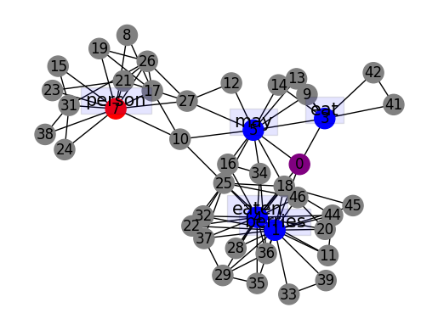
03
Study Meeting
LearnData Lab
LearnData Lab @SKKU
OpenBookQA(695)
Q. “Some berries may be eaten by"
A. a bear or person B. a bear or shake C. a bear or lion D. a bear or wolf
Total cycle 개수 91개
C, Q, A cycle 개수 : 51개
Context node 사이클 : 2개
Question node(1~5) 사이클
1 -> 15, 2 -> 0, 3 -> 5, 4 -> 15, 5 -> 8
Answer node(6,7) 사이클
6 -> 0, 7 -> 13

Slide 23
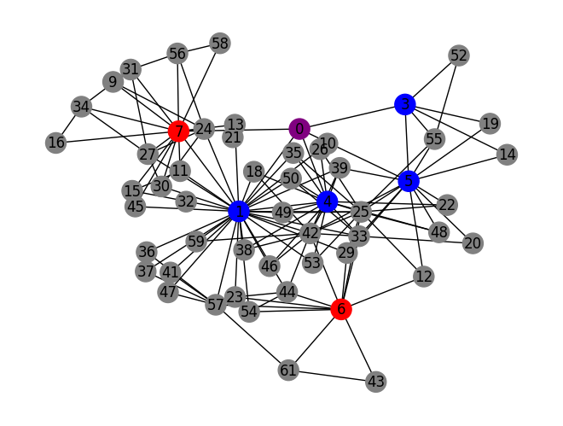
03
Study Meeting
LearnData Lab
LearnData Lab @SKKU
OpenBookQA(695)-QAGNN
Q. “Some berries may be eaten by"
A. a bear or person B. a bear or shake C. a bear or lion D. a bear or wolf
Total cycle 개수 126개
C, Q, A cycle 개수 : 76개
Context node 사이클 : 3개
Question node(1~5) 사이클
1 -> 29, 2 -> 0, 3 -> 4, 4 -> 14, 5 -> 12
Answer node(6,7) 사이클
6 -> 9, 7 -> 20
eat
lion
eaten
may
berries
bear

Slide 24
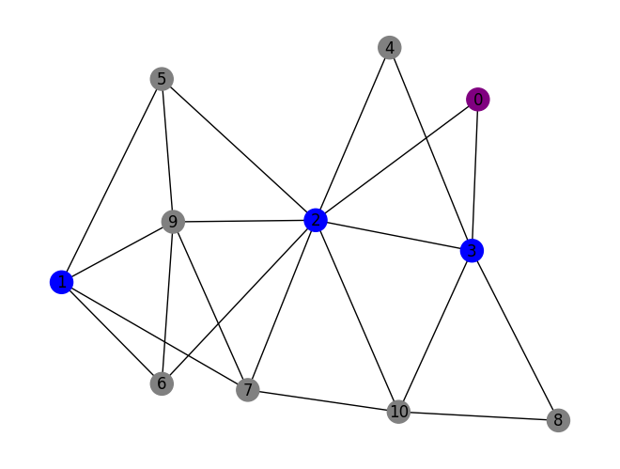
03
Study Meeting
LearnData Lab
LearnData Lab @SKKU
OpenBookQA(788)
Q. “Owls are likely to hunt at"
A. 3pm B. 2am C. 6pm D. 7am
Total cycle 개수 13개
C, Q, A cycle 개수 : 11개
Context node 사이클 : 1개
Question node(1~3) 사이클
1 -> 3, 2 -> 7, 3 -> 4
Answer node(4) 사이클 : 0개
owl
owls
hunt

Slide 25
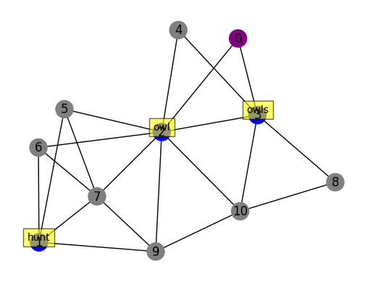
03
Study Meeting
LearnData Lab
LearnData Lab @SKKU
OpenBookQA(788)-QAGNN
Q. “Owls are likely to hunt at"
A. 3pm B. 2am C. 6pm D. 7am
Total cycle 개수 13개
C, Q, A cycle 개수 : 11개
Context node 사이클 : 1개
Question node(1~3) 사이클
1 -> 3, 2 -> 7, 3 -> 4
Answer node(4) 사이클 : 0개

Slide 26
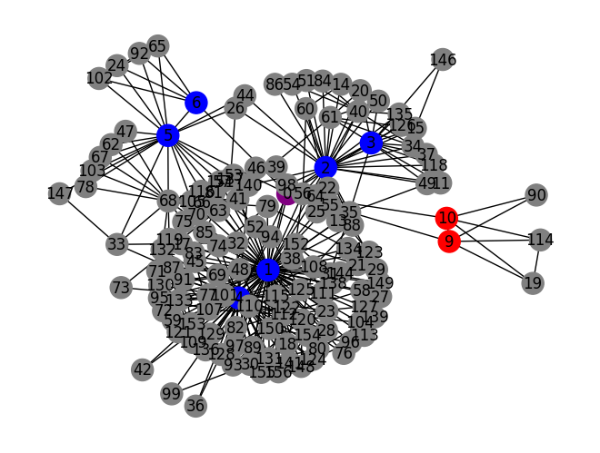
03
Study Meeting
LearnData Lab
LearnData Lab @SKKU
OpenBookQA(7-671)
Q. “If a UFO is flying overhead and looks small, then large, then"
A. the UFO is calling B. the UFO had been close C. the UFO is approaching D. the UFO is leaving
overhead
Total cycle 개수 408개
C, Q, A cycle 개수 : 184개
Context node 사이클 : 5개
Question node(1~7) 사이클
1 -> 80, 2 -> 26, 3 -> 10, 4 -> 51, 5 -> 16, 6 -> 4, 7 -> 0
Answer node(8~10) 사이클
8 -> 0, 9 -> 4, 10 -> 5
looks
large
flying
UFO
approaching
fly
look

Slide 27
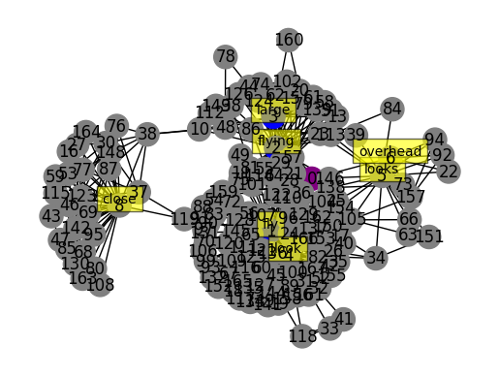
03
Study Meeting
LearnData Lab
LearnData Lab @SKKU
OpenBookQA(7-671)-QAGNN
Q. “If a UFO is flying overhead and looks small, then large, then"
A. the UFO is calling B. the UFO had been close C. the UFO is approaching D. the UFO is leaving
Total cycle 개수 476개
C, Q, A cycle 개수 : 234개
Context node 사이클 : 4개
Question node(1~7) 사이클
1 -> 74, 2 -> 29, 3 -> 16, 4 -> 46, 5 -> 13, 6 -> 4, 7 -> 0
Answer node(8,9) 사이클
8 -> 58, 9 -> 0

Slide 28
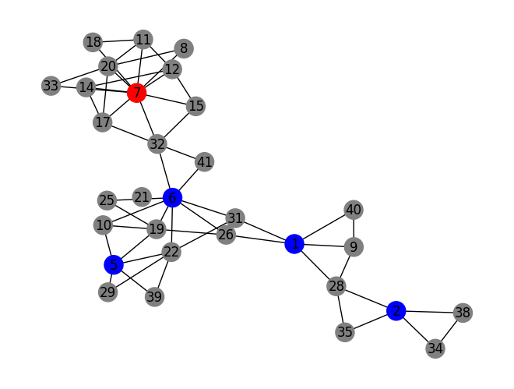
03
Study Meeting
LearnData Lab
LearnData Lab @SKKU
OpenBookQA(75)
Q. “The amount of friction and the speed of an object have what kind of relationship?"
A. inverse B. reverse C. direct D. equal
Total cycle 개수 35개
C, Q, A cycle 개수 : 25개
Context node 사이클 : 0개
Question node(1~6) 사이클
1 -> 3, 2 -> 2, 3 -> 0, 4 -> 0, 5 -> 3, 6 -> 6
Answer node(7) 사이클 : 11개
inverse
speed
amount
relationship
friction

Slide 29
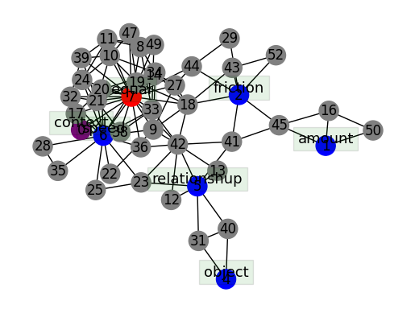
03
Study Meeting
LearnData Lab
LearnData Lab @SKKU
OpenBookQA(75)-QAGNN
Q. “The amount of friction and the speed of an object have what kind of relationship?"
A. inverse B. reverse C. direct D. equal
Total cycle 개수 74개
C, Q, A cycle 개수 : 62개
Context node 사이클 : 1개
Question node(1~6) 사이클
1 -> 2 2 -> 4, 3 -> 0, 4 -> 1, 5 -> 5, 6 -> 14
Answer node(7) 사이클 : 47개

Slide 30
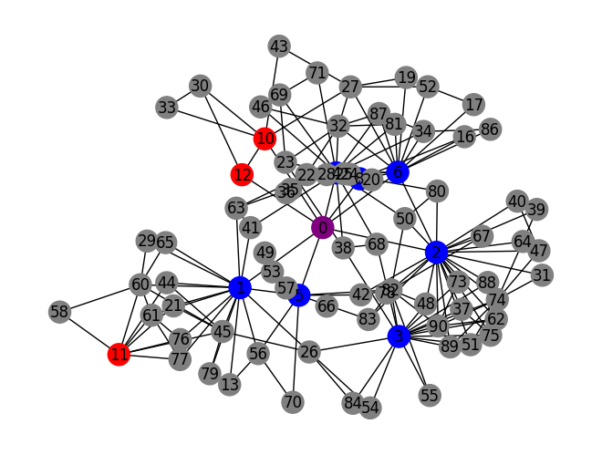
03
Study Meeting
LearnData Lab
LearnData Lab @SKKU
OpenBookQA(7-664)
Q. “If bacon is left too long on a hot stove top”
A. it will be cooked perfectly B. it will be bacteria laden C. it will become blackened D. it will be left raw
stove_top
leave
Total cycle 개수 152개
C, Q, A cycle 개수 : 95개
Context node 사이클 : 5개
Question node(1~9) 사이클
1 -> 13, 2 -> 20, 3 -> 13, 4 -> 14, 5 -> 4, 6 -> 13, 7 -> 0, 8 -> 2, 9 -> 0
Answer node(10~12) 사이클
10 -> 4, 11 -> 7, 12 -> 2
become
blackened
long
hot
bacon
left
blacken
hot_stove

Slide 31
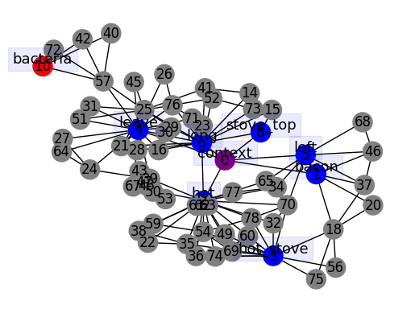
03
Study Meeting
LearnData Lab
LearnData Lab @SKKU
OpenBookQA(7-664)-QAGNN
Q. “If bacon is left too long on a hot stove top”
A. it will be cooked perfectly B. it will be bacteria laden C. it will become blackened D. it will be left raw
Total cycle 개수 111개
C, Q, A cycle 개수 : 62개
Context node 사이클 : 4개
Question node(1~9) 사이클
1 -> 4, 2 -> 15, 3 -> 9, 4 -> 15, 5 -> 5, 6 -> 13, 7 -> 0, 8 -> 2, 9 -> 0
Answer node(10~11) 사이클
10 -> 3, 11 -> 0

Slide 32
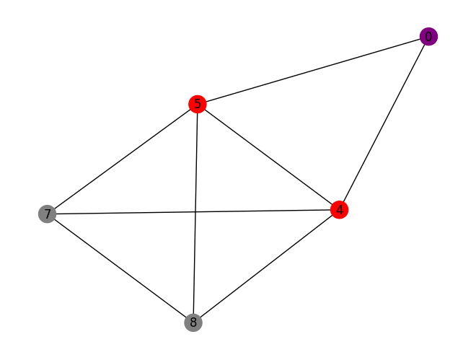
03
Study Meeting
LearnData Lab
LearnData Lab @SKKU
OpenBookQA(8-53)
Q. “the dashboard reading in a jaguar would likely be set to which of these?”
A. set to calories B. set to volume C. set to kilometers D. set to width
Total cycle 개수 4개
C, Q, A cycle 개수 : 4개
Context node 사이클 : 1개
Question node(1,2) 사이클
1 -> 0, 2 ->0
Answer node(3~6) 사이클
3 -> 0, 4 ->3 , 5 ->4 , 6 ->0
set
kilometers

Slide 33
03
Study Meeting
LearnData Lab
LearnData Lab @SKKU
OpenBookQA(8-53)-QAGNN
Q. “the dashboard reading in a jaguar would likely be set to which of these?”
A. set to calories B. set to volume C. set to kilometers D. set to width
Total cycle 개수 2개
C, Q, A cycle 개수 : 2개
Context node 사이클 : 1개
Question node(1,2) 사이클
1 -> 0, 2 ->0
Answer node(3~5) 사이클
3 -> 2, 4 -> 2, 5 -> 0
set
kilometers

Slide 34
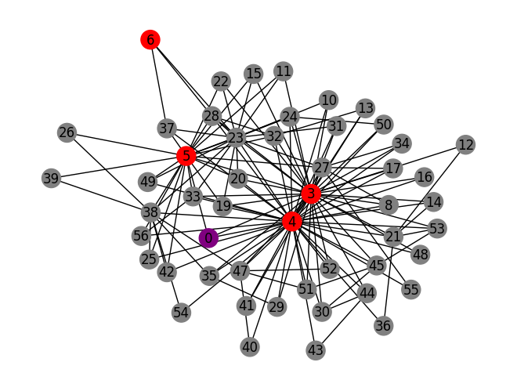
03
Study Meeting
LearnData Lab
LearnData Lab @SKKU
OpenBookQA(7-140)
Q. “A person can see”
A. a radio recording B. an emotion C. a written message D. an abstract idea
written
Total cycle 개수 179개
C, Q, A cycle 개수 : 88개
Context node 사이클 : 2개
Question node(1,2) 사이클
1 -> 0, 2 ->0
Answer node(3~7) 사이클
3 -> 32, 4 -> 40, 5 -> 19, 6 -> 2, 7 -> 0
message
write_message
write

Slide 35
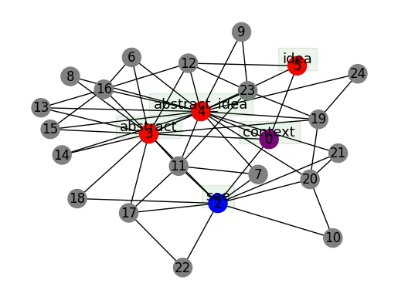
03
Study Meeting
LearnData Lab
LearnData Lab @SKKU
OpenBookQA(7-140)-QAGNN
Q. “A person can see”
A. a radio recording B. an emotion C. a written message D. an abstract idea
Total cycle 개수 38개
C, Q, A cycle 개수 : 32개
Context node 사이클 : 3개
Question node(1,2) 사이클
1 -> 0, 2 ->7
Answer node(3~5) 사이클
3 -> 13, 4 -> 17, 5 -> 2

Slide 36
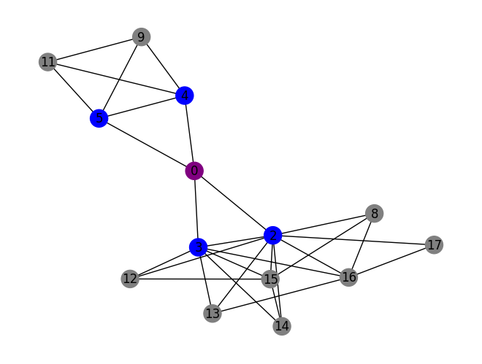
03
Study Meeting
LearnData Lab
LearnData Lab @SKKU
OpenBookQA(9-464)
Q. “Rainbows are always found after what?”
A. A fire B. A tornado C. Rainfall D. Cereal
Total cycle 개수 13개
C, Q, A cycle 개수 : 13개
Context node 사이클 : 2개
Question node(1~5) 사이클
1 -> 0, 2 ->7, 3 -> 4, 4 -> 2, 5 -> 2
Answer node(6) 사이클 : 0개
rainbow
rainbows
find
found

Slide 37
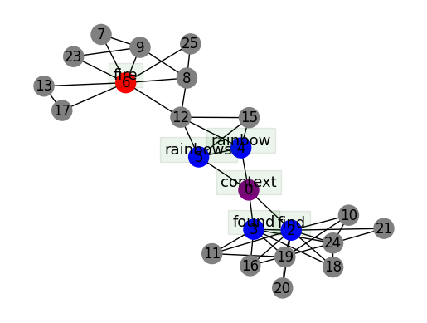
03
Study Meeting
LearnData Lab
LearnData Lab @SKKU
OpenBookQA(9-464)-QAGNN
Q. “Rainbows are always found after what?”
A. A fire B. A tornado C. Rainfall D. Cereal
Total cycle 개수 22개
C, Q, A cycle 개수 : 20개
Context node 사이클 : 2개
Question node(1~5) 사이클
1 -> 0, 2 ->8, 3 -> 4, 4 -> 2, 5 -> 2
Answer node(6) 사이클 : 6개

Slide 38
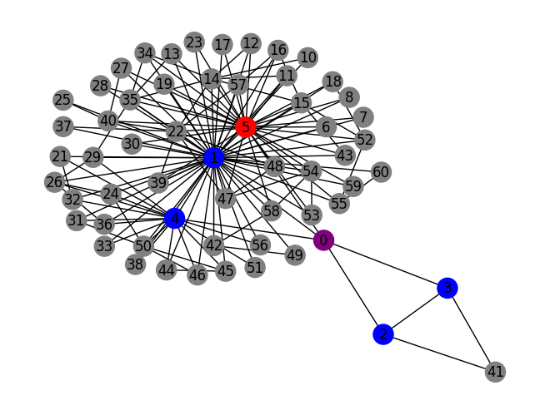
03
Study Meeting
LearnData Lab
LearnData Lab @SKKU
OpenBookQA(9-30)
Q. “Which animal is considered a predator?”
A. ant B. snake C. elephant D. giraffe
snake
Total cycle 개수 94개
C, Q, A cycle 개수 : 90개
Context node 사이클 : 3개
Question node(1~4) 사이클
1 -> 54, 2 ->2, 3 -> 2, 4 -> 16
Answer node(5) 사이클 : 57개
considered
animal
consider
predator

Slide 39
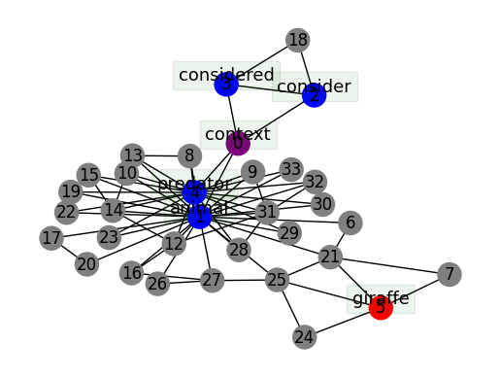
03
Study Meeting
LearnData Lab
LearnData Lab @SKKU
OpenBookQA(9-30)-QAGNN
Q. “Which animal is considered a predator?”
A. ant B. snake C. elephant D. giraffe
Total cycle 개수 43개
C, Q, A cycle 개수 : 36개
Context node 사이클 : 2개
Question node(1~4) 사이클
1 -> 2, 2 ->2, 3 -> 2, 4 -> 17
Answer node(5) 사이클 : 3개

Slide 40
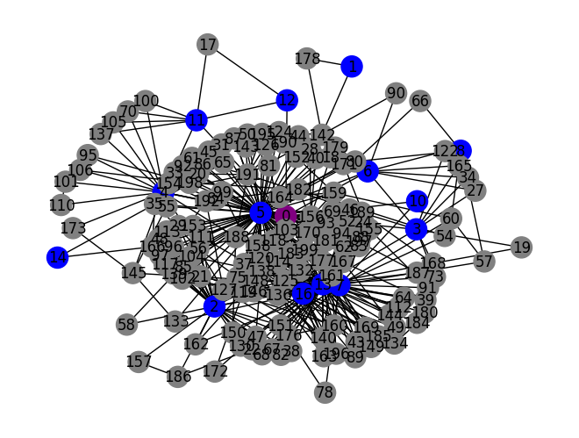
03
Study Meeting
LearnData Lab
LearnData Lab @SKKU
OpenBookQA(429)
Q. “The unit of measure derived from French word millilitre is a unit used for measuring volume generally used for values between 1 and”
A. 1000 B. 250 C. 5000 D. 300
derive
Total cycle 개수 : 327개
C, Q, A cycle 개수 : 230개
Context node 사이클 : 12개
Question node(1~16) 사이클
1 -> 1, 2 ->24, 3 -> 9, 4 -> 19, 5 -> 80, 6 -> 7, 7 -> 17, 8 -> 2, 9 -> 0, 10 -> 1, 11 -> 7, 12 -> 2, 13 -> 62, 14 -> 1, 15 -> 0, 16 -> 70
Answer node(17) 사이클 : 0개
use
used
french_word
measuring
measure
generally
unit
values
french
measure_volume
derived
value
word

Slide 41
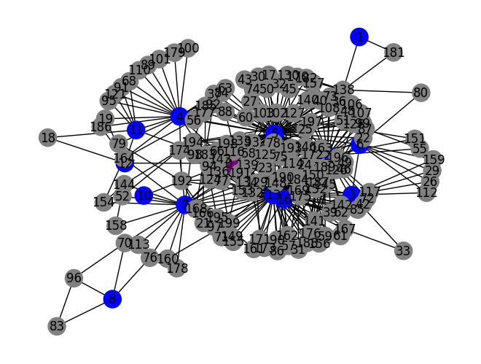
03
Study Meeting
LearnData Lab
LearnData Lab @SKKU
OpenBookQA(429)-QAGNN
Q. “The unit of measure derived from French word millilitre is a unit used for measuring volume generally used for values between 1 and”
A. 1000 B. 250 C. 5000 D. 300
generally
french_word
derive
use
Total cycle 개수 : 352개
C, Q, A cycle 개수 : 242개
Context node 사이클 : 12개
Question node(1~16) 사이클
1 -> 1, 2 ->25, 3 -> 9, 4 -> 18, 5 -> 77, 6 -> 7, 7 -> 18, 8 -> 3, 9 -> 0, 10 -> 1, 11 -> 7, 12 -> 2, 13 -> 74, 14 -> 0, 15 -> 0, 16 -> 71
Answer node(17) 사이클 : 0개
measure
used
derived
french
unit
word
value
measuring
measure_volume

Slide 42
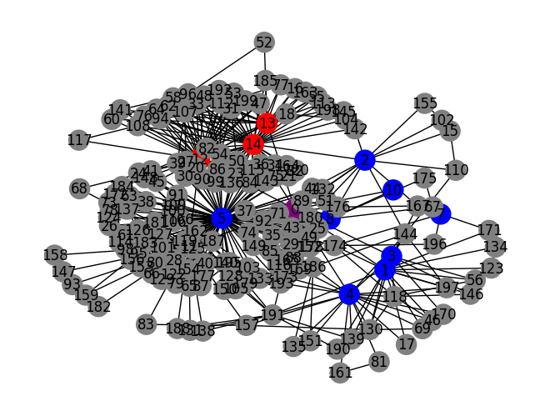
03
Study Meeting
LearnData Lab
LearnData Lab @SKKU
OpenBookQA(7-394)
Q. “Light from further away may appear to be less bright than other, closer sources, such as in which instance?”
A. The sun is always bright B. the moon is brighter than stars C. the moon is brighter than a floodlight D. the sun is darker than the moon
star
Total cycle 개수 : 366개
C, Q, A cycle 개수 : 250개
Context node 사이클 : 12개
Question node(1~10) 사이클
1 -> 12, 2 ->8, 3 -> 6, 4 -> 17, 5 -> 88, 6 -> 0, 7 -> 1, 8 -> 11, 9 -> 0, 10 -> 1
Answer node(11~14) 사이클
11 -> 34, 12 -> 31, 13 -> 19, 14 -> 102
moon
stars
away
sources
light
may
close
appear
instance
closer

Slide 43
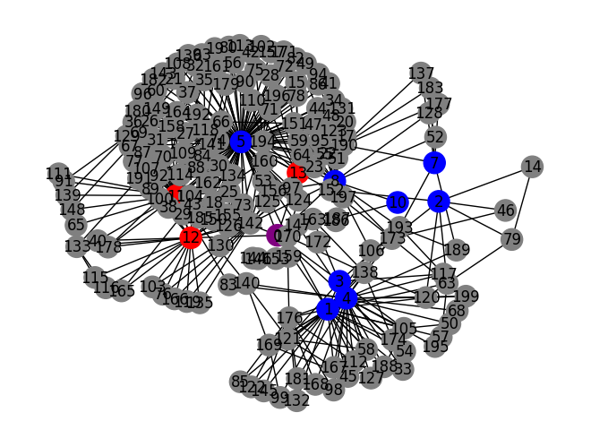
03
Study Meeting
LearnData Lab
LearnData Lab @SKKU
OpenBookQA(7-394)-QAGNN
Q. “Light from further away may appear to be less bright than other, closer sources, such as in which instance?”
A. The sun is always bright B. the moon is brighter than stars C. the moon is brighter than a floodlight D. the sun is darker than the moon
instance
moon
Total cycle 개수 : 384개
C, Q, A cycle 개수 : 206개
Context node 사이클 : 8개
Question node(1~10) 사이클
1 -> 20, 2 ->5, 3 -> 5, 4 -> 22, 5 -> 96, 6 -> 0, 7 -> 4, 8 -> 16, 9 -> 0, 10 -> 1
Answer node(11~13) 사이클
11 -> 33, 12 -> 19, 13 -> 10
light
may
sources
away
bright
floodlight
close
closer
appear

Slide 44
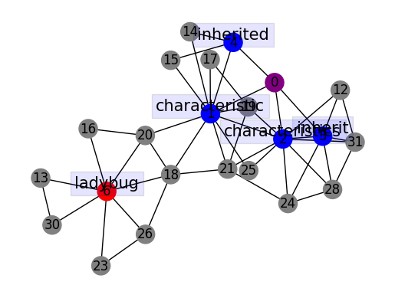
03
Study Meeting
LearnData Lab
LearnData Lab @SKKU
OpenBookQA(1300)
Q. “Inherited characteristics”
A. include mice being able to navigate a maze B. include learning to sit on command C. include dolphins doing tricks for their trainers D. include spots on a ladybug
Total cycle 개수 : 23개
C, Q, A cycle 개수 : 23개
Context node 사이클 : 3개
Question node(1~4) 사이클
1 -> 9, 2 -> 8, 3 -> 4, 4 -> 3
Answer node(5~9) 사이클
5 -> 0, 6 -> 5, 7 -> 0, 8 -> 0, 9 -> 0

Slide 45
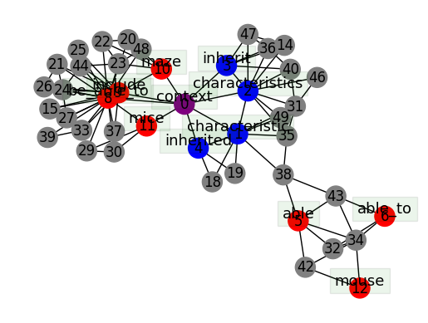
03
Study Meeting
LearnData Lab
LearnData Lab @SKKU
OpenBookQA(1300)-QAGNN
Q. “Inherited characteristics”
A. include mice being able to navigate a maze B. include learning to sit on command C. include dolphins doing tricks for their trainers D. include spots on a ladybug
Total cycle 개수 : 55개
C, Q, A cycle 개수 : 49개
Context node 사이클 : 6개
Question node(1~4) 사이클
1 -> 7, 2 -> 9, 3 -> 4, 4 -> 3
Answer node(5~13) 사이클
5 -> 4, 6 -> 2, 7 -> 0, 8 -> 16, 9 -> 9, 10 -> 3, 11 -> 4, 12 -> 1, 13 -> 0

Slide 46
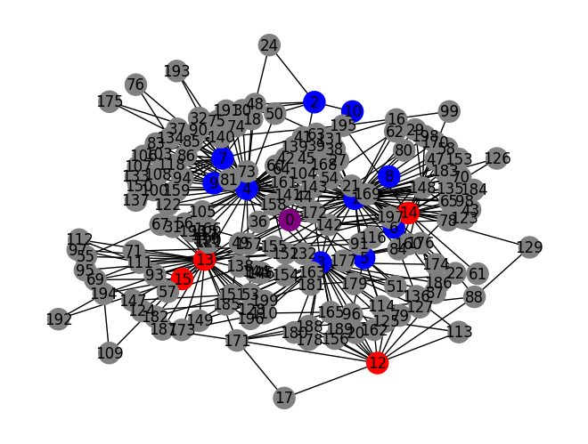
03
Study Meeting
LearnData Lab
LearnData Lab @SKKU
OpenBookQA(7-823)
Q. “A toaster converts electrical energy into heat energy for toasting much like”
A. a campfire toasts bread B. a microwave heats soup C. a fire burns paper D. a small oven works
heat_energy
convert
converts
like
Total cycle 개수 : 316개
C, Q, A cycle 개수 : 204개
Context node 사이클 : 13개
Question node(1~11) 사이클
1 -> 51, 2 -> 4, 3 -> 24, 4 -> 55, 5 -> 5, 6 -> 3, 7 -> 23, 8 -> 1, 9 -> 3, 10 -> 1, 11 -> 0
Answer node(12~15) 사이클
12 -> 13, 13 -> 34, 14 -> 14, 15 ->7
much_like
much
small
work
works
heat
electrical_energy
oven
energy
electrical

Slide 47
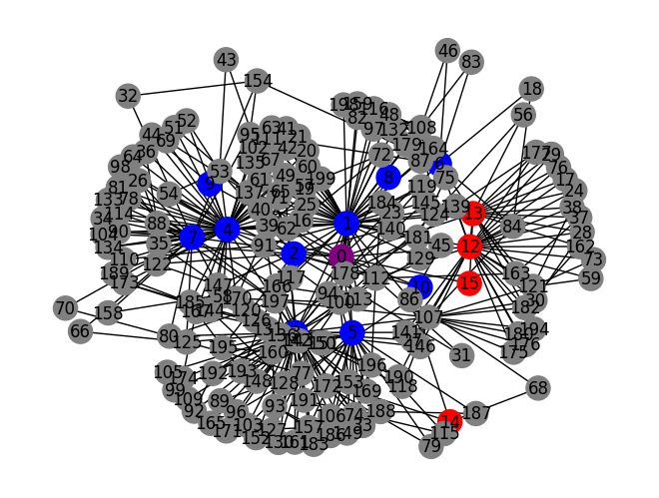
03
Study Meeting
LearnData Lab
LearnData Lab @SKKU
OpenBookQA(7-823)-QAGNN
Q. “A toaster converts electrical energy into heat energy for toasting much like”
A. a campfire toasts bread B. a microwave heats soup C. a fire burns paper D. a small oven works
much
converts
like
convert
Total cycle 개수 : 372개
C, Q, A cycle 개수 : 215개
Context node 사이클 : 15개
Question node(1~11) 사이클
1 -> 51, 2 -> 10, 3 -> 54, 4 -> 49, 5 -> 15, 6 -> 6, 7 -> 21, 8 -> 1, 9 -> 2, 10 -> 1, 11 -> 0
Answer node(12~15) 사이클
12 -> 26, 13 -> 14, 14 -> 2, 15 ->1
heat
heat_energy
campfire
bread
toasts
electrical_energy
much_like
toast
electrical
energy

Slide 48
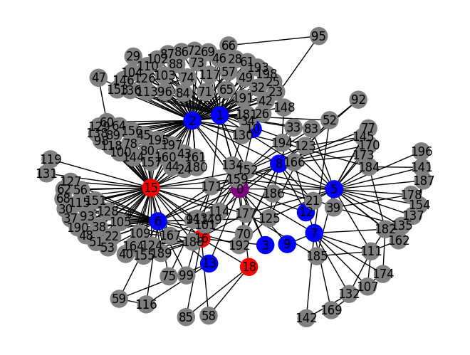
03
Study Meeting
LearnData Lab
LearnData Lab @SKKU
OpenBookQA(9-124)
Q. “The pull the human planet space rock orbiter has on certain bodies of dihydrogen monoxide results in?”
A. telescope views B. water level fluctuations C. animal D. plant harvesting
bodies
pull
body
orbiter
Total cycle 개수 : 196개
C, Q, A cycle 개수 : 172개
Context node 사이클 : 12개
Question node(1~14) 사이클
1 -> 42, 2 -> 67, 3 -> 2, 4 -> 0, 5 -> 23, 6 -> 27, 7 -> 8, 8 -> 14, 9 -> 1, 10 -> 4, 11 -> 0, 12 -> 1, 13 -> 4, 14 -> 0
Answer node(15~18) 사이클
15 -> 55, 16 -> 12, 17 -> 0, 18 -> 3
fluctuation
dihydrogen
human
rock
water_level
human_planet
level
planet
certain
space

Slide 49
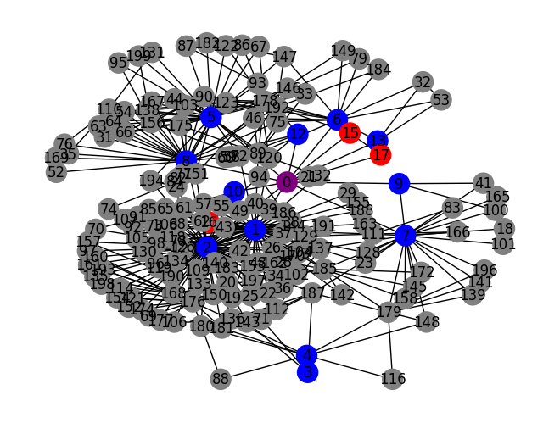
03
Study Meeting
LearnData Lab
LearnData Lab @SKKU
OpenBookQA(9-124)-QAGNN
Q. “The pull the human planet space rock orbiter has on certain bodies of dihydrogen monoxide results in?”
A. telescope views B. water level fluctuations C. animal D. plant harvesting
result
bodies
rock
planet
human
human_planet
Total cycle 개수 : 336개
C, Q, A cycle 개수 : 179개
Context node 사이클 : 23개
Question node(1~14) 사이클
1 -> 51, 2 -> 73, 3 -> 2, 4 -> 5, 5 -> 29, 6 -> 10, 7 -> 18, 8 -> 20, 9 -> 2, 10 -> 2, 11 -> 0, 12 -> 3, 13 -> 4, 14 -> 0
Answer node(15~17) 사이클
15 -> 2, 16 -> 2, 17 -> 1
body
telescope
space
orbiter
views
pull
dihydrogen
view
certain

Slide 50
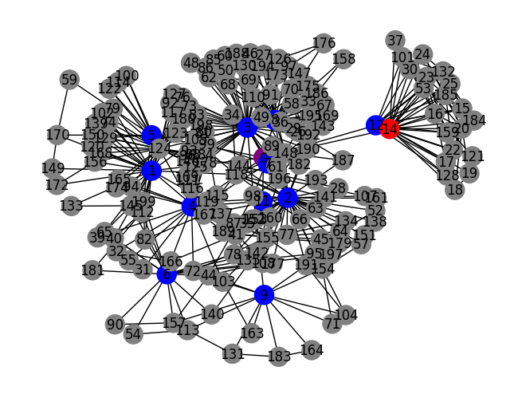
03
Study Meeting
LearnData Lab
LearnData Lab @SKKU
OpenBookQA(8-346)
Q. “What would be the flavor if you ate the item that fell and is though to have hit Sir Issac Newton’s head”
A. Sweet B. Salty C. bitter D. sour
ate
fall
issac_newton
flavor
Total cycle 개수 : 500개
C, Q, A cycle 개수 : 233개
Context node 사이클 : 6개
Question node(1~13) 사이클
1 -> 25, 2 -> 35, 3 -> 53, 4 -> 18, 5 -> 7, 6 -> 11, 7 -> 1, 8 -> 33, 9 -> 9, 10 -> 0, 11 -> 1, 12 -> 14, 13 -> 0
Answer node(14) 사이클 : 53개
think
sweet
hit
fell
eat
sir
head
item

Slide 51
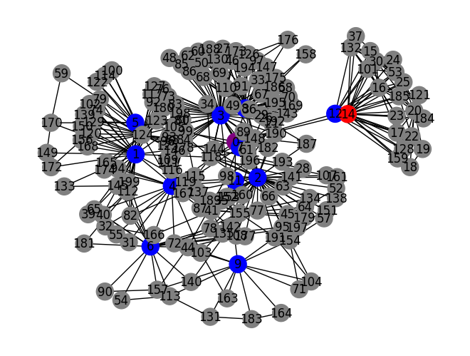
03
Study Meeting
LearnData Lab
LearnData Lab @SKKU
OpenBookQA(8-346)-QAGNN
Q. “What would be the flavor if you ate the item that fell and is though to have hit Sir Issac Newton’s head”
A. Sweet B. Salty C. bitter D. sour
fall
issac_newton
ate
flavor
Total cycle 개수 : 500개
C, Q, A cycle 개수 : 233개
Context node 사이클 : 6개
Question node(1~13) 사이클
1 -> 25, 2 -> 35, 3 -> 53, 4 -> 18, 5 -> 7, 6 -> 11, 7 -> 1, 8 -> 33, 9 -> 9, 10 -> 0, 11 -> 1, 12 -> 14, 13 -> 0
Answer node(14) 사이클 : 53개
think
salty
fell
hit
eat
sir
head
item

Slide 52
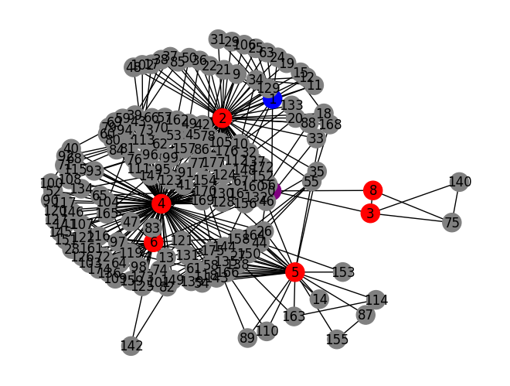
03
Study Meeting
LearnData Lab
LearnData Lab @SKKU
OpenBookQA(7-1050)
Q. “Evaporation”
A. only happens in the summer B. is like nature’s disappearing water trick C. is caused by snow D. involves the disappearance of sunlight
Total cycle 개수 : 459개
C, Q, A cycle 개수 : 237개
Context node 사이클 : 3개
Question node(1) 사이클 : 14
Answer node(2~8) 사이클
2 -> 81, 3 -> 3, 4 -> 117, 5 -> 20, 6 -> 12, 7 -> 0, 8 -> 2
evaporation
be_like
trick
disappear
like
nature
disappearing

Slide 53
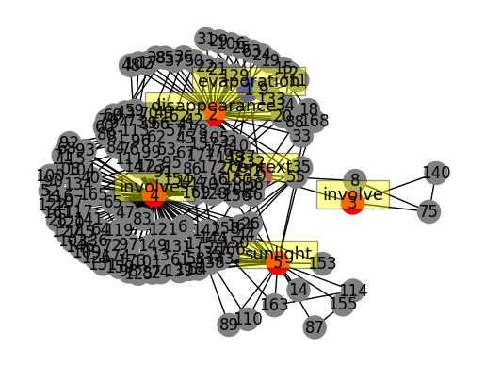
03
Study Meeting
LearnData Lab
LearnData Lab @SKKU
OpenBookQA(7-1050)-QAGNN
Q. “Evaporation”
A. only happens in the summer B. is like nature’s disappearing water trick C. is caused by snow D. involves the disappearance of sunlight
Total cycle 개수 : 459개
C, Q, A cycle 개수 : 228개
Context node 사이클 : 3개
Question node(1) 사이클 : 14
Answer node(2~5) 사이클
2 -> 81, 3 -> 3, 4 -> 117, 5 -> 20

Slide 54
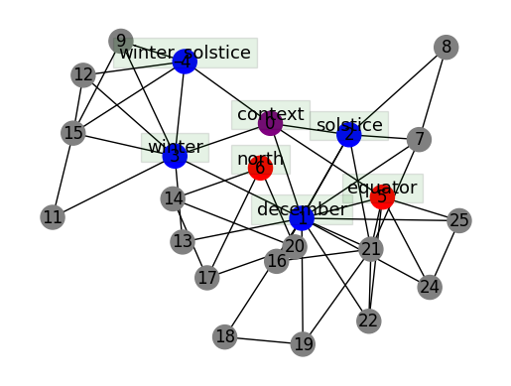
03
Study Meeting
LearnData Lab
LearnData Lab @SKKU
OpenBookQA(9-32)
Q. “The winter solstice is on December 21st in the”
A. counties B. north of equator C. states D. southern hemisphere
Total cycle 개수 : 27개
C, Q, A cycle 개수 : 26개
Context node 사이클 : 4개
Question node(1~4) 사이클
1 -> 12, 2 -> 3, 3 -> 4, 4 -> 2
Answer node(5,6) 사이클
5 -> 2, 6 -> 3

Slide 55

03
Study Meeting
LearnData Lab
LearnData Lab @SKKU
OpenBookQA(9-32)-QAGNN
Q. “The winter solstice is on December 21st in the”
A. counties B. north of equator C. states D. southern hemisphere
Total cycle 개수 : 26개
C, Q, A cycle 개수 : 22개
Context node 사이클 : 5개
Question node(1~4) 사이클
1 -> 9, 2 -> 3, 3 -> 5, 4 -> 3
Answer node(5,6) 사이클
5 -> 2, 6 -> 3, 7 -> 5

Slide 56

03
Study Meeting
LearnData Lab
LearnData Lab @SKKU
OpenBookQA(636)
Q. “Members of rock bands often perform with”
A. flutes B. sandals C. earplugs D. gloves
Total cycle 개수 : 223개
C, Q, A cycle 개수 : 134개
Context node 사이클 : 7개
Question node(1~9) 사이클
1 -> 62, 2 -> 1, 3 -> 12, 4 -> 29, 5 -> 16, 6 -> 11, 7 -> 6, 8 -> 12, 9 -> 1
Answer node(10,11) 사이클
10 -> 1, 11 -> 2
earplugs
bands
members
rock
earplug
rock_bands
rock_band
often
perform
member
band

Slide 57

03
Study Meeting
LearnData Lab
LearnData Lab @SKKU
OpenBookQA(636)-QAGNN
Q. “Members of rock bands often perform with”
A. flutes B. sandals C. earplugs D. gloves
often
rock
band
Total cycle 개수 : 220개
C, Q, A cycle 개수 : 132개
Context node 사이클 : 8개
Question node(1~9) 사이클
1 -> 61, 2 -> 1, 3 -> 11, 4 -> 33, 5 -> 15, 6 -> 9, 7 -> 3, 8 -> 7, 9 -> 1
Answer node(10,11) 사이클
10 -> 8, 11 -> 9
members
rock_band
rock_bands
perform
sandal
member
sandals
bands

Slide 58

03
Study Meeting
LearnData Lab
LearnData Lab @SKKU
OpenBookQA(745)
Q. “Wax can be used similarly to”
A. wood B. rubber C. water D. metal
Total cycle 개수 : 84개
C, Q, A cycle 개수 : 57개
Context node 사이클 : 2개
Question node(1~4) 사이클
1 -> 25, 2 -> 15, 3 -> 9, 4 -> 0
Answer node(5) 사이클 : 13개

Slide 59

03
Study Meeting
LearnData Lab
LearnData Lab @SKKU
OpenBookQA(745)-QAGNN
Q. “Wax can be used similarly to”
A. flutes B. sandals C. earplugs D. gloves
Total cycle 개수 : 84개
C, Q, A cycle 개수 : 57개
Context node 사이클 : 2개
Question node(1~4) 사이클
1 -> 25, 2 -> 15, 3 -> 9, 4 -> 0
Answer node(5) 사이클 : 13개

Slide 60

03
Study Meeting
LearnData Lab
LearnData Lab @SKKU
OpenBookQA(9-638)
Q. “A moth leaving it’s cocoon is the funal step in a”
A. life cycle B. transformation C. recycling process D. chemical reaction
Total cycle 개수 : 84개
C, Q, A cycle 개수 : 46개
Context node 사이클 : 2개
Question node(1~6) 사이클
1 -> 5, 2 -> 25, 3 -> 4, 4 -> 1, 5 -> 9, 6 -> 3
Answer node(7) 사이클 : 2개

Slide 61

03
Study Meeting
LearnData Lab
LearnData Lab @SKKU
OpenBookQA(9-638)-QAGNN
Q. “A moth leaving it’s cocoon is the funal step in a”
A. life cycle B. transformation C. recycling process D. chemical reaction
Total cycle 개수 : 131개
C, Q, A cycle 개수 : 60개
Context node 사이클 : 3개
Question node(1~6) 사이클
1 -> 4, 2 -> 21, 3 -> 5, 4 -> 1, 5 -> 11, 6 -> 3
Answer node(7,8) 사이클
7 -> 16, 8 -> 2

Slide 62

03
Study Meeting
LearnData Lab
LearnData Lab @SKKU
OpenBookQA(9-105)
Q. “if you put wine from a jug into a thin bottle, how come it conforms?”
A. it exhibits absolute rigidity B. it is a solid mass C. all of these D. it is a variable substance
conform
come
Total cycle 개수 : 264개
C, Q, A cycle 개수 : 174개
Context node 사이클 : 4개
Question node(1~8) 사이클
1 -> 7, 2 -> 51, 3 -> 42, 4 -> 18, 5 -> 0, 6 -> 1, 7 -> 1, 8 -> 1
Answer node(9,10) 사이클
9 -> 0, 10 -> 71
thin
wine
variable
put
conforms
bottle

Slide 63

03
Study Meeting
LearnData Lab
LearnData Lab @SKKU
OpenBookQA(9-105)-QAGNN
Q. “if you put wine from a jug into a thin bottle, how come it conforms?”
A. it exhibits absolute rigidity B. it is a solid mass C. all of these D. it is a variable substance
come
conform
exhibit
absolute
Total cycle 개수 : 221개
C, Q, A cycle 개수 : 146개
Context node 사이클 : 4개
Question node(1~8) 사이클
1 -> 12, 2 -> 55, 3 -> 50, 4 -> 23, 5 -> 3, 6 -> 1, 7 -> 28, 8 -> 1
Answer node(9~12) 사이클
9 -> 2, 10 -> 2, 11 -> 1, 12 -> 1
rigidity
thin
exhibits
conforms
wine
jug
put
bottle

Slide 64

03
Study Meeting
LearnData Lab
LearnData Lab @SKKU
OpenBookQA(8-367)
Q. “Building new areas to dispose of refuse may lead to”
A. community concerns over environmental impact B. better air and soil quality C. higher value on land parcels D. improvement in water supply
Total cycle 개수 : 166개
C, Q, A cycle 개수 : 88개
Context node 사이클 : 2개
Question node(1~8) 사이클
1 -> 1, 2 -> 3, 3 -> 17, 4 -> 1, 5 -> 15, 6 -> 1, 7 -> 40, 8 -> 3
Answer node(9~13) 사이클
9 -> 6, 10 -> 2, 11 -> 0, 12 -> 0, 13 -> 1

Slide 65

03
Study Meeting
LearnData Lab
LearnData Lab @SKKU
OpenBookQA(8-367)-QAGNN
Q. “Building new areas to dispose of refuse may lead to”
A. community concerns over environmental impact B. better air and soil quality C. higher value on land parcels D. improvement in water supply
Total cycle 개수 : 166개
C, Q, A cycle 개수 : 88개
Context node 사이클 : 2개
Question node(1~8) 사이클
1 -> 1, 2 -> 3, 3 -> 17, 4 -> 1, 5 -> 15, 6 -> 1, 7 -> 40, 8 -> 3
Answer node(9~13) 사이클
9 -> 6, 10 -> 2, 11 -> 0, 12 -> 0, 13 -> 1

Slide 66

03
Study Meeting
LearnData Lab
LearnData Lab @SKKU
OpenBookQA(9-776)
Q. “Which of these saws will last longer?”
A. iron saw B. aluminium saw C. plastic saw D. wooden saw
Total cycle 개수 : 18개
C, Q, A cycle 개수 : 13개
Context node 사이클 : 1개
Question node(1~4) 사이클
1 -> 0, 2 -> 2, 3 -> 1, 4 -> 0
Answer node(5~7) 사이클
5 -> 4, 6 -> 4, 7 -> 4

Slide 67

03
Study Meeting
LearnData Lab
LearnData Lab @SKKU
OpenBookQA(9-776)-QAGNN
Q. “Which of these saws will last longer?”
A. iron saw B. aluminium saw C. plastic saw D. wooden saw
Total cycle 개수 : 18개
C, Q, A cycle 개수 : 13개
Context node 사이클 : 1개
Question node(1~4) 사이클
1 -> 0, 2 -> 2, 3 -> 1, 4 -> 0
Answer node(5~7) 사이클
5 -> 0, 6 -> 2, 7 -> 0

Slide 68

03
Study Meeting
LearnData Lab
LearnData Lab @SKKU
OpenBookQA(1823)
Q. “Cellular respiration’s trash is”
A. a bug’s treasure B. a cow’s treasure C. a plant’s treasure D. everyone’s trash
Total cycle 개수 : 10개
C, Q, A cycle 개수 : 9개
Context node 사이클 : 1개
Question node(1~4) 사이클
1 -> 0, 2 -> 2, 3 -> 0, 4 -> 1
Answer node(5,6) 사이클
5 -> 7, 6 -> 0

Slide 69

03
Study Meeting
LearnData Lab
LearnData Lab @SKKU
OpenBookQA(1823)-QAGNN
Q. “Cellular respiration’s trash is”
A. a bug’s treasure B. a cow’s treasure C. a plant’s treasure D. everyone’s trash
Total cycle 개수 : 2개
C, Q, A cycle 개수 : 2개
Context node 사이클 : 1개
Question node(1~3) 사이클
1 -> 0, 2 -> 1, 3 -> 0
Answer node(4,5) 사이클
4 -> 1, 5 -> 1

Slide 70

03
Study Meeting
LearnData Lab
LearnData Lab @SKKU
OpenBookQA(7-262)
Q. “A warm-weather organism can be found in”
A. the Sahara B. the mountains C. the ocean D. the sewers
Total cycle 개수 : 43개
C, Q, A cycle 개수 : 32개
Context node 사이클 : 2개
Question node(1~5) 사이클
1 -> 8, 2 -> 6, 3 -> 3, 4 -> 17, 5 -> 0
Answer node(6) 사이클 : 0개

Slide 71

03
Study Meeting
LearnData Lab
LearnData Lab @SKKU
OpenBookQA(7-262)-QAGNN
Q. “A warm-weather organism can be found in”
A. the Sahara B. the mountains C. the ocean D. the sewers
Total cycle 개수 : 51개
C, Q, A cycle 개수 : 38개
Context node 사이클 : 3개
Question node(1~5) 사이클
1 -> 7, 2 -> 6, 3 -> 2, 4 -> 16, 5 -> 1
Answer node(6,7) 사이클
6 -> 7, 7 -> 8

Slide 72

03
Study Meeting
LearnData Lab
LearnData Lab @SKKU
OpenBookQA(597)
Q. “The heart is an example of”
A. a part of the nervous system B. an organ that filters toxins C. a self-healing protector from germs D. something protected by the skeletal system
Total cycle 개수 : 42개
C, Q, A cycle 개수 : 24개
Context node 사이클 : 2개
Question node(1,2) 사이클
1 -> 3, 2 -> 0
Answer node(3~7) 사이클
3 -> 5, 4 -> 5, 5 -> 10, 6 -> 1, 7 -> 3

Slide 73

03
Study Meeting
LearnData Lab
LearnData Lab @SKKU
OpenBookQA(597)-QAGNN
Q. “The heart is an example of”
A. a part of the nervous system B. an organ that filters toxins C. a self-healing protector from germs D. something protected by the skeletal system
Total cycle 개수 : 42개
C, Q, A cycle 개수 : 24개
Context node 사이클 : 2개
Question node(1,2) 사이클
1 -> 3, 2 -> 0
Answer node(3~7) 사이클
3 -> 5, 4 -> 5, 5 -> 10, 6 -> 1, 7 -> 3

Slide 74
03
Study Meeting
LearnData Lab
LearnData Lab @SKKU
OpenBookQA(676)
Q. “Animals have more fat”
A. in the ocean B. in human homes C. in landfills D. in polar areas
Total cycle 개수 : 263개
C, Q, A cycle 개수 : 178개
Context node 사이클 : 2개
Question node(1,2,3) 사이클
1 -> 91, 2 -> 18, 3 ->43
Answer node(4~7) 사이클
4 -> 0, 5 -> 20, 6 -> 2, 7 -> 22

Slide 75

03
Study Meeting
LearnData Lab
LearnData Lab @SKKU
OpenBookQA(676)-QAGNN
Q. “Animals have more fat”
A. in the ocean B. in human homes C. in landfills D. in polar areas
Total cycle 개수 : 214개
C, Q, A cycle 개수 : 149개
Context node 사이클 : 2개
Question node(1,2,3) 사이클
1 -> 82, 2 -> 19, 3 ->51
Answer node(4,5) 사이클
4 -> 3, 5 -> 4

Slide 76

03
Study Meeting
LearnData Lab
LearnData Lab @SKKU
OpenBookQA(7-1053)
Q. “Are deserts characterized by high sunshine?”
A. they get low sunlight B. deserts get surplus sun C. deserts get little sun D. deserts are always cloudy
Total cycle 개수 : 146개
C, Q, A cycle 개수 : 88개
Context node 사이클 : 4개
Question node(1~4) 사이클
1 -> 23, 2 -> 8, 3 ->1, 4 -> 1
Answer node(5~9) 사이클
5 -> 35, 6 -> 1, 7 -> 19, 8 -> 3, 9 -> 13

Slide 77

03
Study Meeting
LearnData Lab
LearnData Lab @SKKU
OpenBookQA(7-1053)-QAGNN
Q. “Are deserts characterized by high sunshine?”
A. they get low sunlight B. deserts get surplus sun C. deserts get little sun D. deserts are always cloudy
Total cycle 개수 : 221개
C, Q, A cycle 개수 :111개
Context node 사이클 : 5개
Question node(1~6) 사이클
1 -> 16, 2 -> 26, 3 ->1, 4 -> 1, 5 -> 20, 6 -> 35
Answer node(7~9) 사이클
7 -> 15, 8 -> 1, 9 -> 13

Slide 78

03
Study Meeting
LearnData Lab
LearnData Lab @SKKU
OpenBookQA(9-957)
Q. “water conservation could be a survival tactic in”
A. The Appalachian Mountains B. New York City C. The Amazon D. The Gobi Desert
Total cycle 개수 : 40개
C, Q, A cycle 개수 : 26개
Context node 사이클 : 3개
Question node(1~5) 사이클
1 -> 11, 2 -> 1, 3 ->1, 4 -> 0, 5 -> 1
Answer node(6~8) 사이클
6 -> 12, 7 -> 3, 8 -> 1

Slide 79

03
Study Meeting
LearnData Lab
LearnData Lab @SKKU
OpenBookQA(9-957)-QAGNN
Q. “water conservation could be a survival tactic in”
A. The Appalachian Mountains B. New York City C. The Amazon D. The Gobi Desert
Total cycle 개수 : 98개
C, Q, A cycle 개수 : 73개
Context node 사이클 : 2개
Question node(1~5) 사이클
1 -> 9, 2 -> 1, 3 ->0, 4 -> 0, 5 -> 1
Answer node(6~8) 사이클
6 -> 81, 7 -> 56, 8 -> 0, 9 -> 0

Slide 80

03
Study Meeting
LearnData Lab
LearnData Lab @SKKU
OpenBookQA(841)
Q. “What element is prevalent in a plateau?”
A. helium B. krypton C. silicon D. neon
Total cycle 개수 : 16개
C, Q, A cycle 개수 : 15개
Context node 사이클 : 1개
Question node(1~3) 사이클
1 -> 13, 2 -> 0, 3 ->0
Answer node(4) 사이클 : 14개

Slide 81

03
Study Meeting
LearnData Lab
LearnData Lab @SKKU
OpenBookQA(841)-QAGNN
Q. “What element is prevalent in a plateau?”
A. helium B. krypton C. silicon D. neon
Total cycle 개수 : 16개
C, Q, A cycle 개수 : 16개
Context node 사이클 : 1개
Question node(1~3) 사이클
1 -> 11, 2 -> 0, 3 ->0
Answer node(4) 사이클 : 15개

Slide 82

03
Study Meeting
LearnData Lab
LearnData Lab @SKKU
OpenBookQA(841)
Q. “Which animal has live births?”
A. poodle B. krypton C. silicon D. neon
Total cycle 개수 : 115개
C, Q, A cycle 개수 : 71개
Context node 사이클 : 3개
Question node(1~5) 사이클
1 -> 16, 2 -> 30, 3 ->28, 4 -> 1, 5 -> 1
Answer node(6) 사이클 : 1개

Slide 83

03
Study Meeting
LearnData Lab
LearnData Lab @SKKU
OpenBookQA(841)-QAGNN
Q. “Which animal has live births?”
A. poodle B. krypton C. silicon D. neon
Total cycle 개수 : 103개
C, Q, A cycle 개수 : 67개
Context node 사이클 : 3개
Question node(1~5) 사이클
1 -> 11, 2 -> 31, 3 ->29, 4 -> 1, 5 -> 1
Answer node(6) 사이클 : 0개

Slide 84

03
Study Meeting
LearnData Lab
LearnData Lab @SKKU
OpenBookQA(9-429)
Q. “A glass of water can undergo a chemical change by adding”
A. a cup of salt B. a cup of dirt C. a cup of water D. a cup of ice
chemical_change
cup
Total cycle 개수 : 388개
C, Q, A cycle 개수 : 273개
Context node 사이클 : 6개
Question node(1~8) 사이클
1 -> 2, 2 -> 88, 3 -> 8, 4 -> 62, 5 -> 19, 6 -> 0, 7 -> 1, 8 -> 0
Answer node(9,10) 사이클
9 -> 50, 10 -> 90
adding
undergo
add
change
chemical
salt

Slide 85

03
Study Meeting
LearnData Lab
LearnData Lab @SKKU
OpenBookQA(9-429)-QAGNN
Q. “A glass of water can undergo a chemical change by adding”
A. a cup of salt B. a cup of dirt C. a cup of water D. a cup of ice
Total cycle 개수 : 343개
C, Q, A cycle 개수 : 216개
Context node 사이클 : 14개
Question node(1~8) 사이클
1 -> 5, 2 -> 16, 3 -> 68, 4 -> 27, 5 -> 0, 6 -> 2, 7 -> 0, 8 -> 92
Answer node(9,10) 사이클
9 -> 20, 10 -> 31
chemical
change

Slide 86

03
Study Meeting
LearnData Lab
LearnData Lab @SKKU
OpenBookQA(9-301)
Q. “A beach ball goes from flat to round once you put what inside of it?”
A. food B. sunlight C. gas D. salt
Total cycle 개수 : 555개
C, Q, A cycle 개수 : 228개
Context node 사이클 : 8개
Question node(1~9) 사이클
1 -> 26, 2 -> 42, 3 -> 22, 4 -> 36, 5 -> 59, 6 -> 15, 7 -> 1, 8 -> 2, 9 -> 3
Answer node(10) 사이클 : 36개
ball
put
go
beach
inside
gas
round
goes
flat
beach_ball

Slide 87

03
Study Meeting
LearnData Lab
LearnData Lab @SKKU
OpenBookQA(9-301)-QAGNN
Q. “A beach ball goes from flat to round once you put what inside of it?”
A. food B. sunlight C. gas D. salt
flat
food
ball
round
Total cycle 개수 : 522개
C, Q, A cycle 개수 : 214개
Context node 사이클 : 8개
Question node(1~9) 사이클
1 -> 38, 2 -> 44, 3 -> 15, 4 -> 35, 5 -> 41, 6 -> 13, 7 -> 1, 8 -> 2, 9 -> 2
Answer node(10) 사이클 : 38개
goes
beach_ball
go
put
beach
inside

Slide 88

03
Study Meeting
LearnData Lab
LearnData Lab @SKKU
OpenBookQA(620)
Q. “In solid phase matter has a/an”
A. concrete configuration B. ambiguous form C. shapeless form D. radioactive glow
Total cycle 개수 : 158개
C, Q, A cycle 개수 : 92개
Context node 사이클 : 4개
Question node(1~4) 사이클
1 -> 45, 2 -> 22, 3 -> 24, 4 -> 1
Answer node(5,6) 사이클
5 -> 9, 6 -> 0

Slide 89

03
Study Meeting
LearnData Lab
LearnData Lab @SKKU
OpenBookQA(620)-QAGNN
Q. “In solid phase matter has a/an”
A. concrete configuration B. ambiguous form C. shapeless form D. radioactive glow
Total cycle 개수 : 158개
C, Q, A cycle 개수 : 92개
Context node 사이클 : 4개
Question node(1~4) 사이클
1 -> 45, 2 -> 22, 3 -> 24, 4 -> 1
Answer node(5,6) 사이클
5 -> 9, 6 -> 0

Slide 90

03
Study Meeting
LearnData Lab
LearnData Lab @SKKU
OpenBookQA(1126)
Q. “Water can turn to vapor”
A. when a pot of water is placed on an off stove burner B. when placing water in a freezer C. when boiling eggs on a stove top D. when placed in a room temperature setting
boiled_egg
boiling_eggs
Total cycle 개수 : 404개
C, Q, A cycle 개수 : 220개
Context node 사이클 : 6개
Question node(1~3) 사이클
1 -> 82, 2 -> 16, 3 -> 24
Answer node(4~15) 사이클
4 -> 41 ,5 -> 19, 6 -> 25, 7 -> 10, 8 -> 19, 9 -> 10, 10 -> 1, 11 -> 4, 12 -> 0, 13 ->0, 14 ->0, 15 ->0
water
egg
egg_on
turn
boiling
boiled_eggs
boil_eggs
vapor
boil

Slide 91

03
Study Meeting
LearnData Lab
LearnData Lab @SKKU
OpenBookQA(1126)-QAGNN
Q. “Water can turn to vapor”
A. when a pot of water is placed on an off stove burner B. when placing water in a freezer C. when boiling eggs on a stove top D. when placed in a room temperature setting
water
vapor
Total cycle 개수 : 328개
C, Q, A cycle 개수 : 194개
Context node 사이클 : 1개
Question node(1~3) 사이클
1 -> 27, 2 -> 8, 3 -> 58
Answer node(4~11) 사이클
4 -> 67 ,5 -> 6, 6 -> 0, 7 -> 30, 8 -> 7, 9 -> 6, 10 -> 1, 11 -> 2
room_temperature
setting
place_in
turn
temperature_setting
temperature
room
place

Slide 92

03
Study Meeting
LearnData Lab
LearnData Lab @SKKU
OpenBookQA(389)
Q. “when a circle is torn it is”
A. doubled B. changed C. a smaller circle D. a square
Total cycle 개수 : 59개
C, Q, A cycle 개수 : 45개
Context node 사이클 : 3개
Question node(1~3) 사이클
1 -> 13, 2 -> 10, 3 -> 2
Answer node(4,5) 사이클
4 -> 23 ,5 -> 3

Slide 93

03
Study Meeting
LearnData Lab
LearnData Lab @SKKU
OpenBookQA(389)-QAGNN
Q. “when a circle is torn it is”
A. doubled B. changed C. a smaller circle D. a square
Total cycle 개수 : 137개
C, Q, A cycle 개수 : 133개
Context node 사이클 : 2개
Question node(1,2) 사이클
1 -> 33, 2 -> 4
Answer node(3,4,5) 사이클
3 -> 3,4 -> 126 ,5 -> 5

Slide 94

03
Study Meeting
LearnData Lab
LearnData Lab @SKKU
OpenBookQA(948)
Q. “An instinctual behavior is”
A. Dogs rolling over on command B. frogs returning to the ponds were they hached to lay eggs C. birds mimicking human speech D. seals clapping for treats from trainers
Total cycle 개수 : 245개
C, Q, A cycle 개수 : 119개
Context node 사이클 : 3개
Question node(1,2) 사이클
1 -> 0, 2 -> 0
Answer node(3~10) 사이클
3 -> 44, 4 -> 48, 5 -> 7, 6 -> 25, 7 -> 0, 8 -> 3, 9 -> 2, 10 ->1

Slide 95

03
Study Meeting
LearnData Lab
LearnData Lab @SKKU
OpenBookQA(948)-QAGNN
Q. “An instinctual behavior is”
A. Dogs rolling over on command B. frogs returning to the ponds were they hached to lay eggs C. birds mimicking human speech D. seals clapping for treats from trainers
Total cycle 개수 : 222개
C, Q, A cycle 개수 : 132개
Context node 사이클 : 11개
Question node(1,2) 사이클
1 -> 1, 2 -> 0
Answer node(3~17) 사이클
3 -> 22, 4 -> 64 ,5 -> 11, 6 -> 6, 7 -> 9, 8 -> 14, 9 -> 22, 10 ->2, 11 -> 4, 12 -> 3, 13 -> 0, 14 -> 0, 15 -> 0, 16 -> 1, 17 -> 0

Slide 96

03
Study Meeting
LearnData Lab
LearnData Lab @SKKU
OpenBookQA(9-652)
Q. “A plant that gets extra minerals such as zinc are probably”
A. planted in zinc pills B. plated in the sea C. placed in good soil D. made out of soil
Total cycle 개수 : 45개
C, Q, A cycle 개수 : 45개
Context node 사이클 : 7개
Question node(1~9) 사이클
1 -> 12, 2 -> 31, 3 -> 1, 4 -> 1, 5 -> 0, 6 -> 3, 7 -> 1, 8 -> 2, 9 -> 0
Answer node(10~14) 사이클
10 -> 2, 11 -> 1, 12 -> 26, 13 -> 0, 14 -> 1

Slide 97

03
Study Meeting
LearnData Lab
LearnData Lab @SKKU
OpenBookQA(9-652)-QAGNN
Q. “A plant that gets extra minerals such as zinc are probably”
A. planted in zinc pills B. plated in the sea C. placed in good soil D. made out of soil
Total cycle 개수 : 54개
C, Q, A cycle 개수 : 52개
Context node 사이클 : 4개
Question node(1~9) 사이클
1 -> 14, 2 -> 35, 3 -> 0, 4 -> 1, 5 -> 0, 6 -> 3, 7 -> 1, 8 -> 2, 9 -> 0
Answer node(10~12) 사이클
10 -> 33, 11 -> 0, 12 -> 1

Slide 98
03
Study Meeting
LearnData Lab
LearnData Lab @SKKU
Thank you!

